Slide 1


DATA-DRIVEN RETENTION STRATEGIES
REDUCING CHURN IN TELECOM WITH PREDICTIVE ANALYTICS
PRESENTED BY: MUHAMMAD IQBAL HILMY IZZULHAQ
JCDS 2502 | BSD

Slide 2



TABLE OF CONTENTS
HYPERPARAMETER TUNING
BUSINESS PROBLEM
RESULTS AND MODEL PERFORMANCE
ANALYTIC APPROACH
MACHINE LEARNING ALGORITHMS
CONCLUSION & RECOMMENDATIONS

Slide 3
BUSINESS PROBLEM
Problem Context:
High churn rates in telecom businesses.
Retaining valuable customers is crucial for revenue stability.
Target Audience:
Stakeholders, Marketing team, Customer Support teams, and Product Development
Goal:
Predict customer churn to reduce churn rates by targeting high-risk customers.

Slide 4
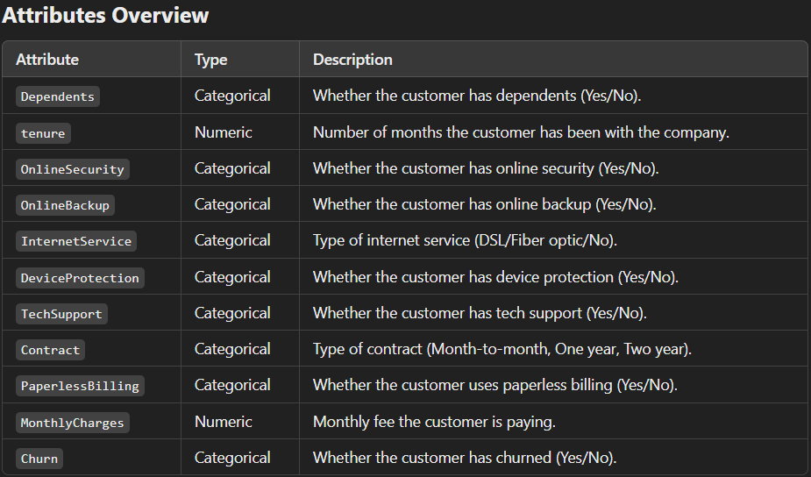
BUSINESS PROBLEM
Data Understanding:
The dataset is focused on customer churn in a telecommunications company.
The data is imbalanced, with more customers not churning.
Features are mostly categorical, including nominal categories like Dependents, OnlineSecurity, OnlineBackup, DeviceProtection, TechSupport, Contract, PaperlessBilling, MonthlyCharges, and Churn. InternetService is an ordinal feature.
Tenure (customer subscription duration) and MonthlyCharges (monthly fee) are numeric.

Slide 5
METRICS EVALUATION
Assumptions:
Customer Lifetime Value (CLV): Average Monthly Charges × 12 Months = 65.32 × 12 = $784
Retention cost (for each customer identified as high-risk): $50
Marketing and retention costs associated with a False Positive (FP): $50 per customer
Loss due to False Negative (FN) (revenue lost from customers who churned but were not identified): $784 per customer
Example:
False Positive (FP): 100 customers incorrectly predicted to churn but actually stayed.
Cost of False Positives = 100 * $50 = $5,000
These are resources spent on customers who didn't need retention efforts.
False Negative (FN): 50 customers incorrectly predicted to stay but actually churned.
Loss due to False Negatives = 50` * $784 = $39,200
This represents the lost revenue from customers who churned without the company being able to intervene.

Slide 6
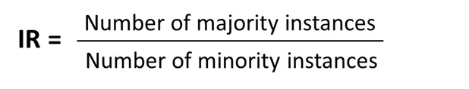
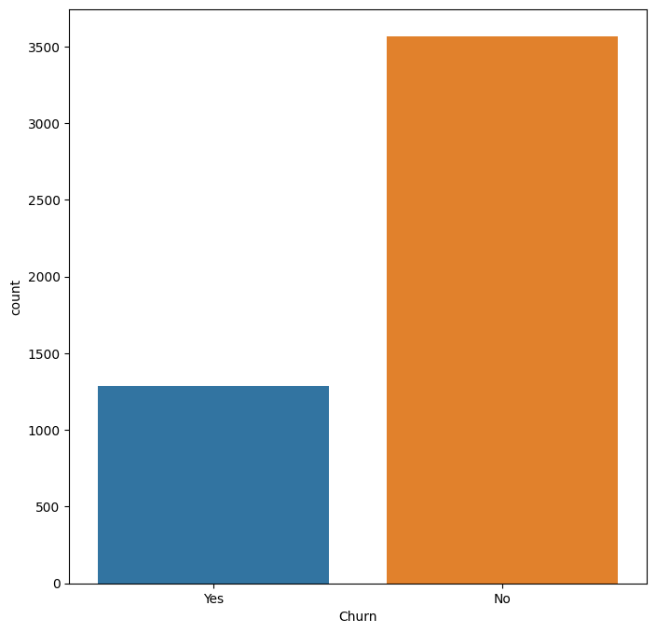
IMBALANCE
According to the value of Imbalance Ratio (IR), the imbalanced datasets are divided into three classes:
* datasets with low imbalance (IR is between 1.5 and 3)
* datasets with medium imbalance (IR is between 3 and 9)
* datasets with high imbalance (IR is higher than 9)]
with 2.77 IR, this datasets is categorized in low imbalance class

Slide 7
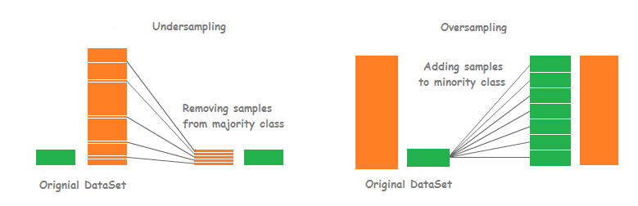
RESAMPLING

Slide 8
ANALYTIC APPROACH
Cross Validation Test:
Approach Used:
Modeling Approach: Classification (using Logistic Regression, XGBoost, Gradient Boosting, KNN, and Random Forest)
Resampling Approach: SMOTE, RandomUnderSampler, RandomOverSampler, Smoteen, NearMiss, TomekLinks, AllKNN, CondensedNearestNeighbour, EditedNearestNeighbours, ADASYN.
Optimum Test Size: 0.2, 0.25, 0.3
Evaluation Metrics: Focusing on Recall (to reduce false negatives), as they are crucial for business.
Why Recall?
False Negative (FN) cost is high: customers who are not identified as high-risk churners.

Slide 9
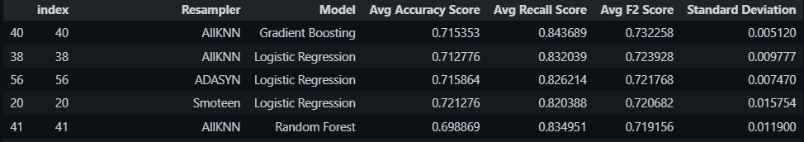
CROSS VALIDATION RESULT
Top 5 Model - Resampler Sort by F2 Score

Slide 10
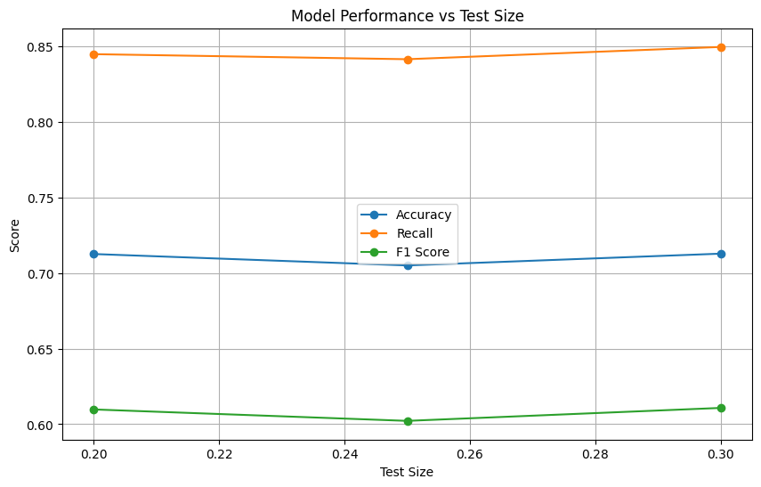
DETERMINE THE BEST TEST SIZE FOR THE MODEL
Optimum Test Size is 30% with higher avg Accuracy, F2, especially Recall, than 25% and 20% Test Size
The accuracy score stands at 71%, which is moderate. However, since the primary focus is to reduce False Negatives (FN), recall is the key metric for evaluation.
False Negatives (FN) are less frequent than False Positives (FP), but their impact is more significant due to the higher associated cost.

Slide 11
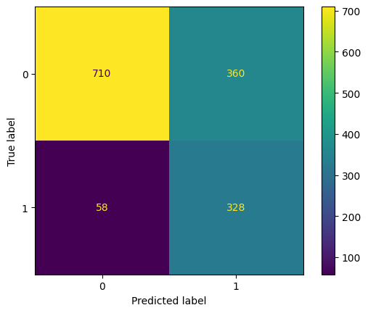
BECHMARK MODEL WITH BEST TEST AND CROSSVAL
Estimated Cost FN and FP in Benchmark Model
FN: 58 x 784 = $45,472
FP: 360 x 50 = $18,000
Total Cost: FN + FP = $63,472

Slide 12
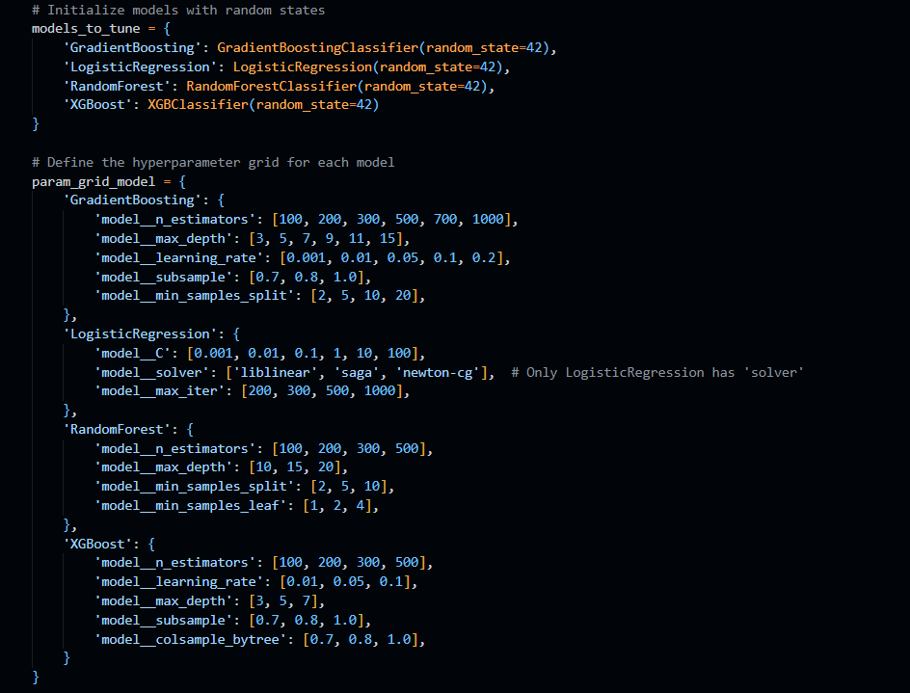
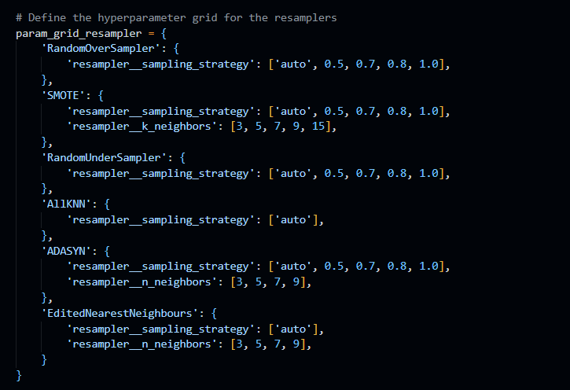
HYPERPARAMETER TUNING

Slide 13
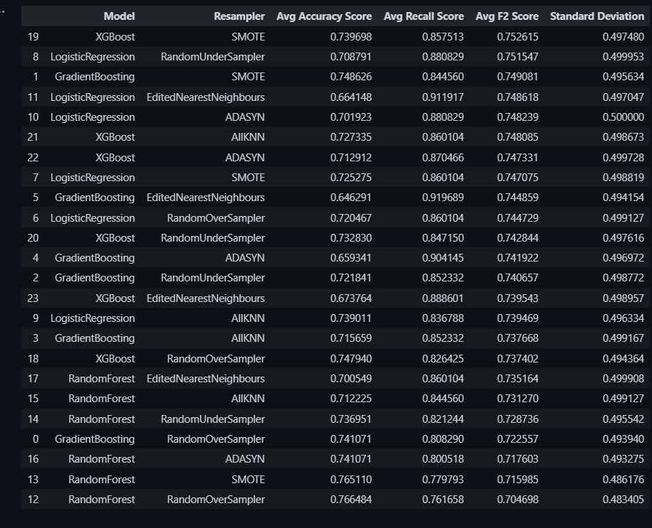
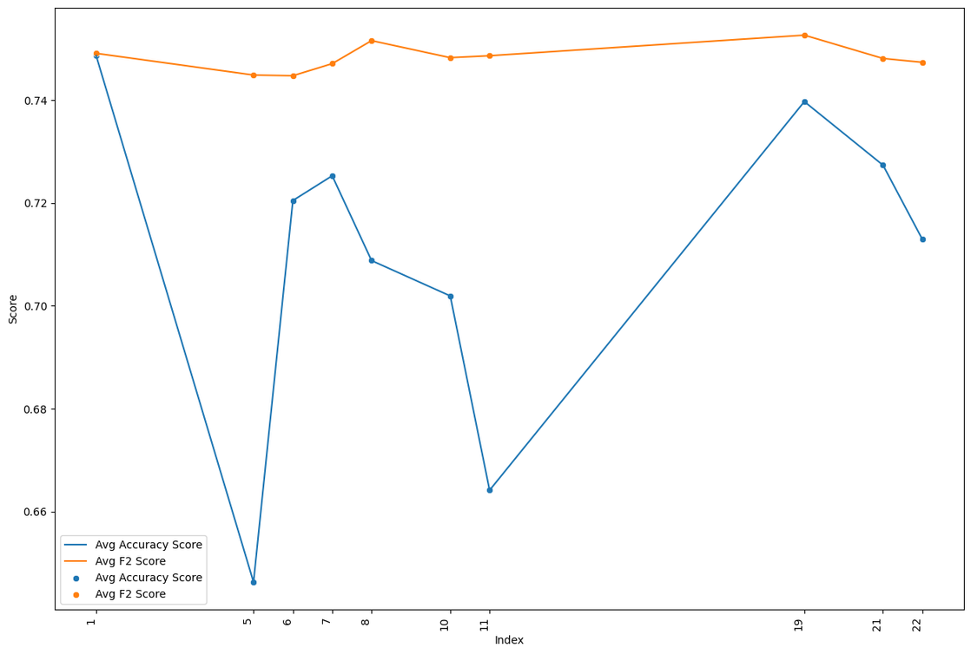
HYPERPARAMETER TUNING

Slide 14
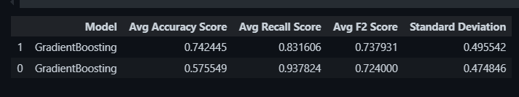
AllKNN vs SMOTE
SMOTE
AllKNN

Slide 15
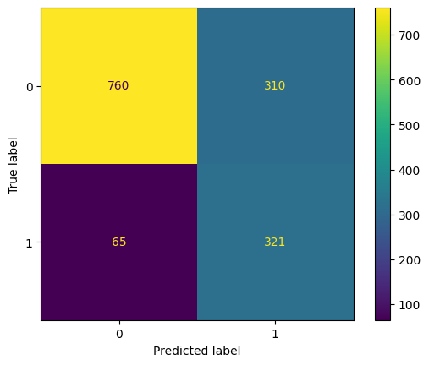
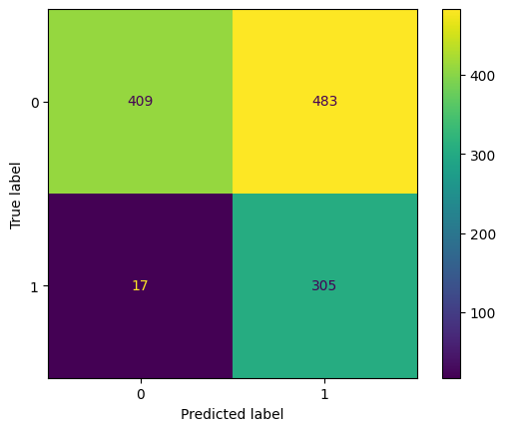
AllKNN vs SMOTE
AllKNN
SMOTE

Slide 16
AllKNN vs SMOTE
AllKNN
SMOTE
Recall Score = 93.7%
Estimated Cost FN and FP in Benchmark Model
FN: 24 x 784 = $18,816
FP: 594 x 50 = $29,700
Total Cost: FN + FP = $48,516
Recall Score = 83.1%
Estimated Cost FN and FP in Benchmark Model
FN: 65 x 784 = $50,960
FP: 310 x 50 = $15,500
Total Cost: FN + FP = $66,130

Slide 17
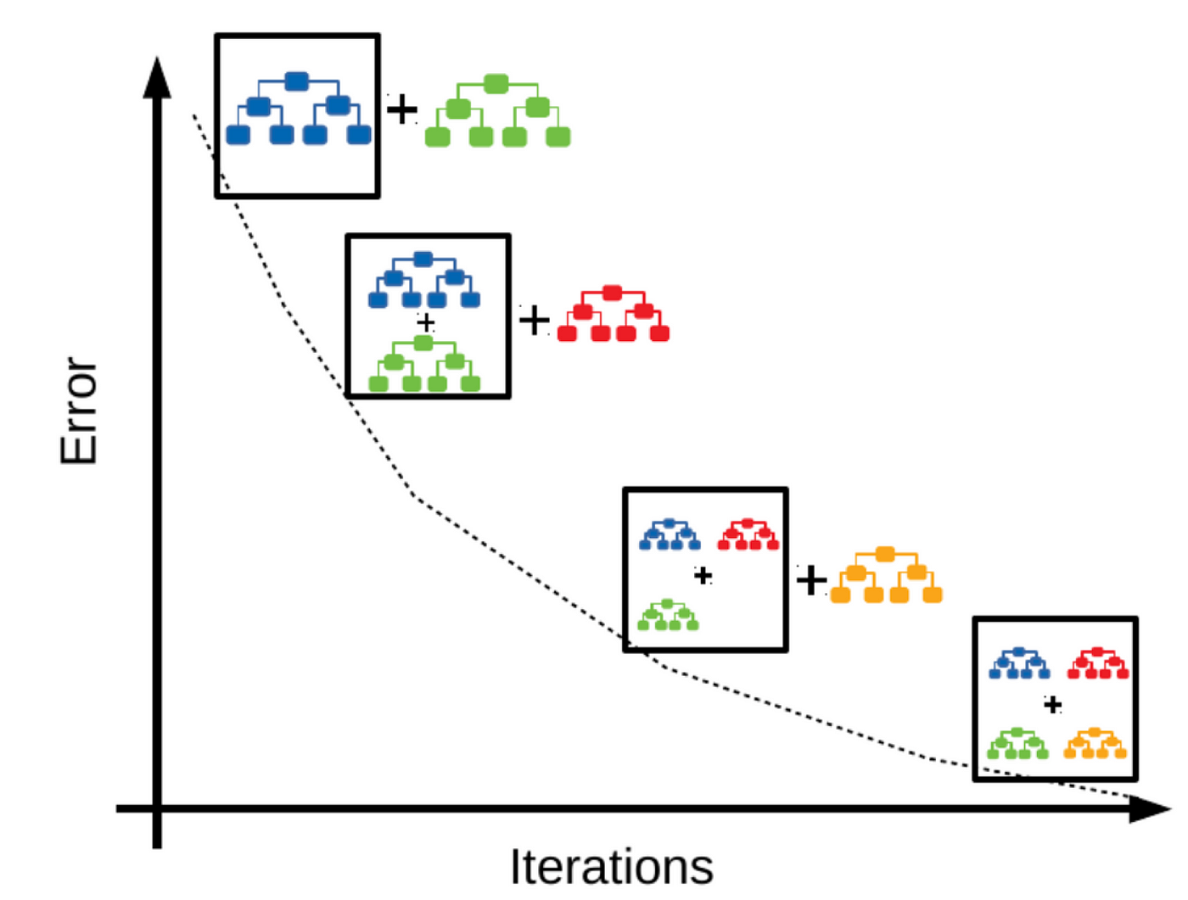
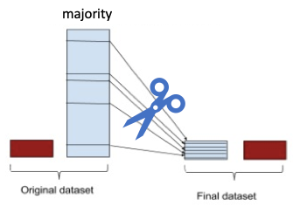
BEST MODEL AND RESAMPLER
GRADIENBOOST AND AllKNN
Notes:
AllKNN (Resampling):
AllKNN adalah teknik resampling yang digunakan untuk menangani dataset yang tidak seimbang, yaitu dengan menyeimbangkan kelas minoritas dan mayoritas. Cara kerjanya adalah dengan menggunakan teknik k-Nearest Neighbors untuk memilih sampel dari kelas minoritas berdasarkan kedekatannya dengan titik-titik lain di dataset.
Proses Resampling: AllKNN memilih data dari kelas minoritas yang paling representatif untuk digunakan dalam pelatihan, sehingga dapat mengurangi bias terhadap kelas mayoritas dan meningkatkan kinerja model pada data yang tidak seimbang.
Gradient Boosting (Model Pembelajaran):
Gradient Boosting adalah teknik ensemble yang membangun model dengan menggabungkan beberapa weak learner (biasanya pohon keputusan) secara berurutan. Setiap model baru dilatih untuk memperbaiki kesalahan model sebelumnya dengan memberi bobot lebih pada data yang salah diprediksi oleh model sebelumnya.
Proses Pembelajaran: Algoritma ini menghitung residuals (kesalahan) dari prediksi model sebelumnya dan melatih model baru berdasarkan kesalahan tersebut. Tujuannya adalah untuk mengurangi kesalahan residual secara iteratif dan menghasilkan model yang lebih kuat dan akurat.

Slide 18
RESULTS AND MODEL PERFORMANCE
Benchmark Model
Tuned Model

Slide 19
RESULTS AND MODEL PERFORMANCE
Benchmark Model
Tuned Model
Recall Score = 85%
Estimated Cost FN and FP in Benchmark Model
FN: 58 x 784 = $45,472
FP: 360 x 50 = $18,000
Total Cost: FN + FP = $63,472
Recall Score = 93.7%
Estimated Cost FN and FP in Benchmark Model
FN: 24 x 784 = $18,816
FP: 594 x 50 = $29,700
Total Cost: FN + FP = $48,516

Slide 20
RESULTS AND MODEL PERFORMANCE
Tuned Model Insight
The accuracy score of the tuned model is 58%, which is lower when compared to the benchmark model.
Despite the significant increase in the FP score, the reduction in FN results in a lower overall cost compared to the benchmark model.
The tuned model’s cost is $48,516, which is $14,956 less than the benchmark model’s cost of $63,472.

Slide 21
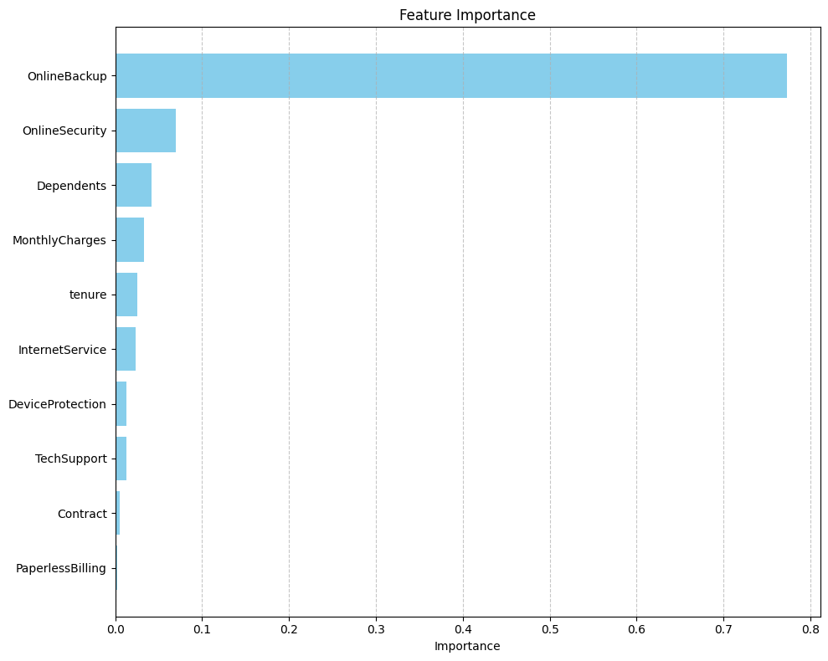
FEATURES IMPORTANCE
OnlineBackup is the most important feature, with a score of 0.75. Customers with or without online backup are strongly linked to churn.
OnlineSecurity follows closely with an importance score of 0.20, suggesting that online security service impacts retention.
Dependents and MonthlyCharges contribute moderately, with scores of 0.10 and 0.05, respectively. Dependents are linked to higher retention, and higher charges slightly affect churn.
Tenure, InternetService, and DeviceProtection are less important, with scores between 0.04 and 0.06.
TechSupport, Contract, and PaperlessBilling have minimal importance, indicating low impact on churn prediction.

Slide 22
CONCLUSION
FN vs FP Cost: The cost of False Negatives (FN) is higher than False Positives (FP). To minimize FN impact, recall is prioritized as the main metric. Improving recall reduces FN costs, which is critical for churn prediction.
Recall vs Accuracy: After tuning the model, recall improves by reducing FN, but FP increases, which lowers accuracy. Even though accuracy drops, recall is more important in this case since reducing FN is more valuable.
Cost Reduction: Despite lower accuracy, the tuned model significantly reduces total costs compared to the benchmark model due to a better FN:FP cost ratio.

Slide 23
RECOMMENDATIONS
Future Evaluation: It's important to carefully determine FN and FP costs to choose the right evaluation metrics and align the model with the goal of minimizing churn and improving retention.
Model Improvement: The current model can be improved by better understanding churn drivers, using advanced resampling techniques, and fine-tuning with more sophisticated methods.
Further Analysis: More exploration of potential features, handling class imbalances better, and incorporating domain expertise will lead to a more reliable model. Regular model retraining and adjustments can improve predictions over time.

Slide 24
THANK YOU

